Slide 1
BIGHERO5
Gautam Ravichandran | Karankumar Parikh | Ashwin Nair | Victoria Green | Young Jun Son

Slide 2
About Us

Slide 3

The Team
Gautam Ravichandran
Karankumar Parikh
Ashwin Nair
Victoria Green
Young Jun Son
Team Coordinator
Java Coder
Front-End Developer Documents Handler
Java Coder Database Manager Backend Developer Documentation
Presentation
QA Analyst Documentation
Java Coder
Java Coder Database Manager GUI Coder/Tester Documentation
Java Coder Documentation
User Guide
QA Analyst

Slide 4
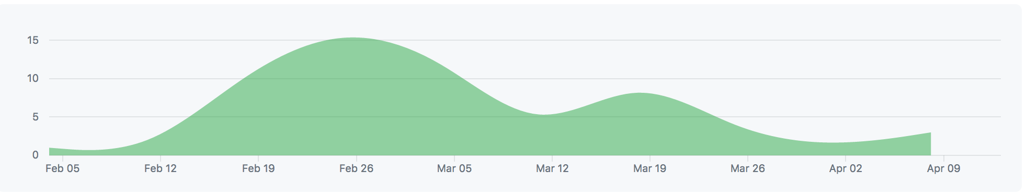
Timeline and Metrics
January | February | March | April
 |  | Implementation
Planning
Code: ~4,000 Lines
Final Report: 32 Pages
Cost: 15.6 Person-Months
Implementation
Finalize

Slide 5

Developmental Tools
Code: Java
GUI: Swing
Database: SQLite
Repository: eGit
IDE : Eclipse

Slide 6
Overview
Purpose: Develop an efficient tool to manage and automate everyday tasks seen in hospitals.
Intuitive
Secure
Reusable
All-In-One

Slide 7
Main Features
Feature 1
Scheduling Appointments
Feature 2
Maintaining Patient Records
Feature 3
Overseeing Pharmacy Inventory
Feature 4
Processing Patient Invoices

Slide 8
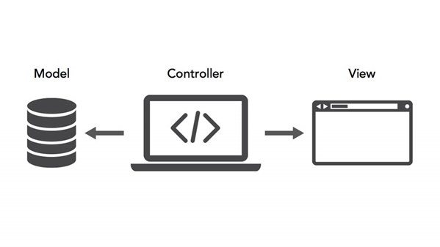
System Model
HMS System Modelling
Our Hospital Management System is conducted in a client-server architecture.
The user’s inputs and actions within the application interact with the server/database as each event either provides access, creates, updates, or deletes content from the server.
The application utilizes a Model-View-Controller architectural structure. In this model, the model is continuously updated by actions conducted by the user and displayed soon after to the user.

Slide 9
Use Cases and Sequence Diagrams

Slide 10
Use Cases

Slide 11
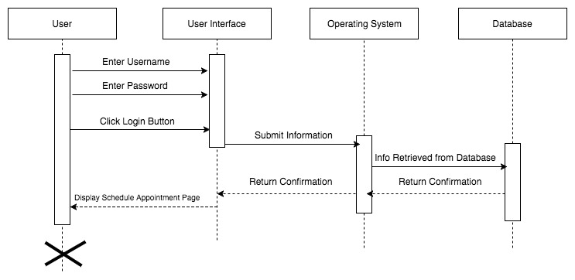
Sequence Diagram: Login
Item 2
Item 3

Slide 12
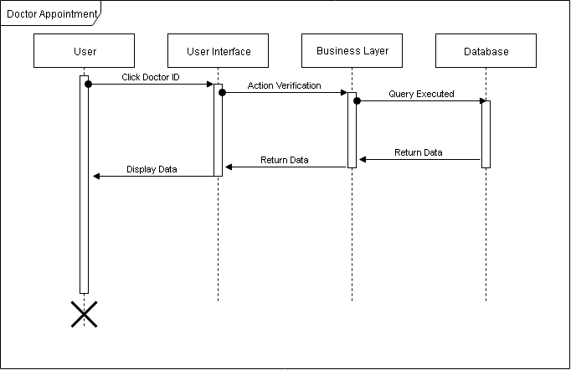
Sequence Diagram: Doctor Appointment
Item 2
Item 3

Slide 13
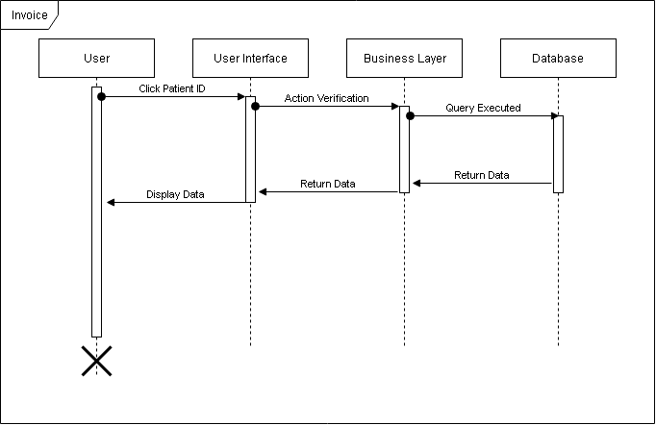
Sequence Diagram: Invoice

Slide 14
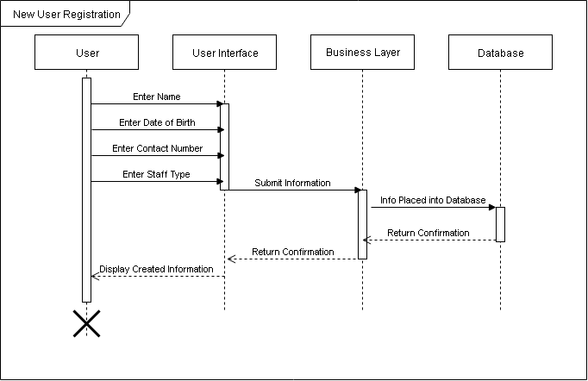
Sequence Diagram: New User Registration

Slide 15
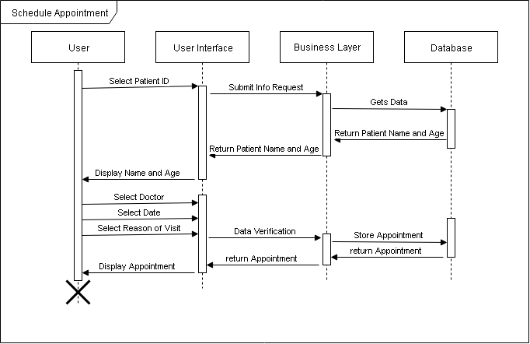
Sequence Diagram: Schedule Appointment

Slide 16
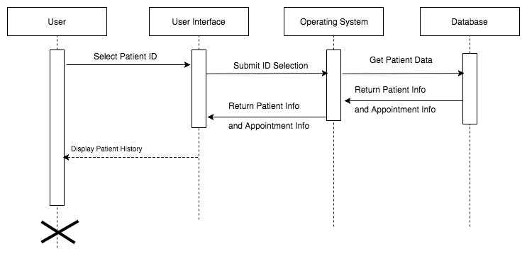
Sequence Diagram: Patient History

Slide 17
Demonstration

Slide 18
Summary
We have created an easy-to-use, multi-user software which demonstrated the following:
Relevant functionality
Comprehensive GUI
Database manipulation
Group productivity

